Slide 1

Relational Data Model Introduction ,Basic Concepts and Integrity Constraints
Department of Computer Engineering and Applications

Slide 2
Relational Model
Relational Model was proposed by E.F. Codd to model data in the form of relations or tables.
RELATIONAL MODEL (RM) represents the database as a collection of relations.
A relation is nothing but a table of values. Every row in the table represents a collection of related data values.
Some popular Relational Database management systems are: Oracle, MySQL, SQL Server, PostgreSQL, IBM DB2, Microsoft Access, SQLite ,MariaDB ,Informix , Azure SQL

Slide 3
Relational Model Basic Concepts
Tables − In relational data model, relations are saved in the format of Tables. A table has rows and columns, where rows represents records and columns represent the attributes.
Attribute: Each column in a Table. Attributes are the properties which define a relation. e.g., Student_Rollno, NAME,etc.
Tuple – It is nothing but a single row of a table, which contains a single record.

Slide 4
Relation Schema: A relation schema represents the name of the relation with its attributes.
Degree: The total number of attributes which in the relation is called the degree of the relation.
Cardinality: Total number of rows present in the Table.
Column: The column represents the set of values for a specific attribute.
Relation instance – Relation instance is a finite set of tuples in the RDBMS system. Relation instances never have duplicate tuples.

Slide 5
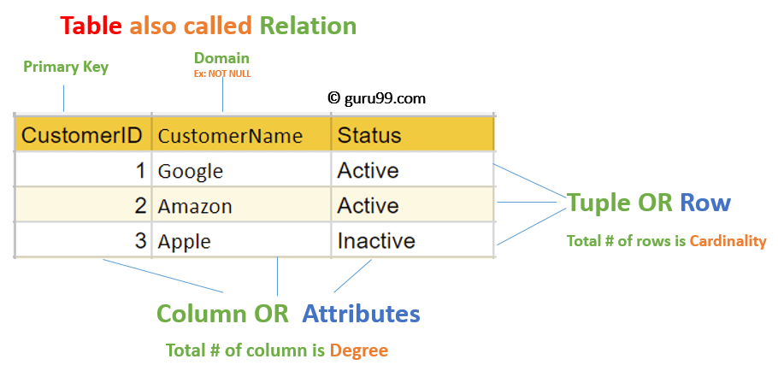
Relation key - Every row has one, two or multiple attributes, which is called relation key.
Attribute domain – Every attribute has some pre-defined value and scope which is known as attribute domain

Slide 6
Integrity Constraints
Integrity constraints are a set of rules. It is used to maintain the quality of information.
Integrity constraints ensure that the data insertion, updating, and other processes have to be performed in such a way that data integrity is not affected.
Thus, integrity constraint is used to guard against accidental damage to the database.

Slide 7
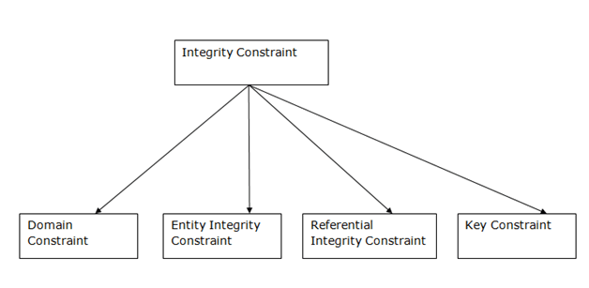
Types of Integrity Constraint

Slide 8
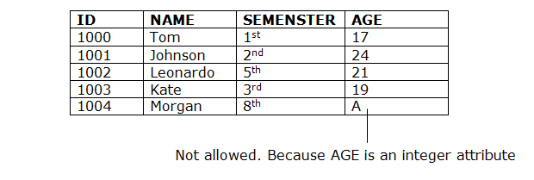
1. Domain constraints
Attributes have specific values in real-world scenario. For example, age can only be a positive integer.
Every attribute is bound to have a specific range of values. For example, age cannot be less than zero and telephone numbers cannot contain a digit outside 0-9.

Slide 9
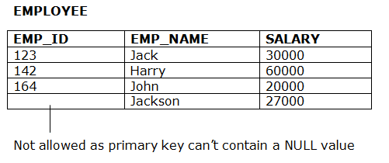
2. Entity integrity constraints
To ensure entity integrity, it is required that every table have a primary key.
The entity integrity constraint states that primary key value can't be null.
This is because the primary key value is used to identify individual rows in relation and if the primary key has a null value, then we can't identify those rows.

Slide 10
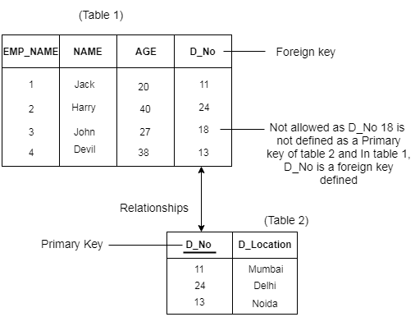
3. Referential Integrity Constraints
It states that if a foreign key exists in a relation then either the foreign key value must match a primary key value of some tuple in its home relation or the foreign key value must be null.

Slide 11
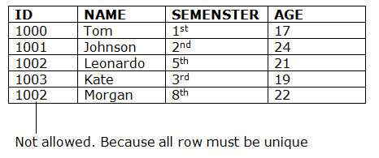
4. Key constraints
An attribute that can uniquely identify a tuple in a relation is called the key of the table. The value of the attribute for different tuples in the relation has to be unique.

